Slide 1

Lecture 14
-NLP is all about words, their arrangement and their meaning
-NLP is a branch of AI that tries to emulate/understand the way a human speaks to another human
-Lecture 14 is about Word Sense Disambiguation (WSD) and how you can take the help of WORDNET lexicon for WSD
[Ch. 20 of Jurafsky Martin]

Slide 2
WSD – Word Sense Disambiguation
WSD: process of selecting the correct sense (meaning) of a word
Applications: machine translation, IR, Dialogue-based systems
Input to the WSD algorithm:
-1) the input word with its context (surrounding words)
-2) list of different senses of the word
Output of WSD algorithm
-correct sense of the word

Slide 3
How to take the help of WordNet for WSD

Slide 4
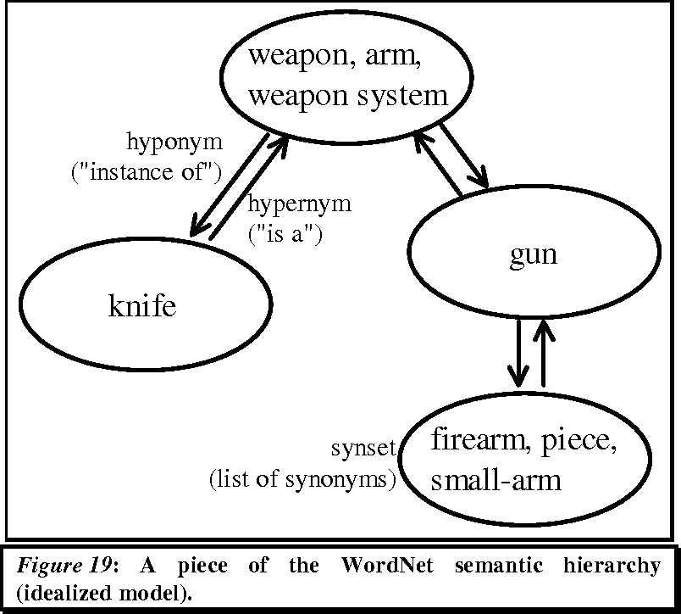
WordNet
WordNet is an online lexicon/database of words and their meanings and their inter-relationships shown in the form of a graph
https://www.semanticscholar.org/paper/Feature-Engineering-for-a-Symbolic-Approach-to-Text-Scott/4868907526fa5e03f3e398bbc4bd02dc937a9c43/figure/30

Slide 5
Method 1
Go for the most frequently used sense
WordNet synsets ranked in the order of 1, 2,…. In order of most frequently used sense (meaning) of a word
So go for the meaning at rank no. 1
Accuracy may be not very high, but very simple technique

Slide 6
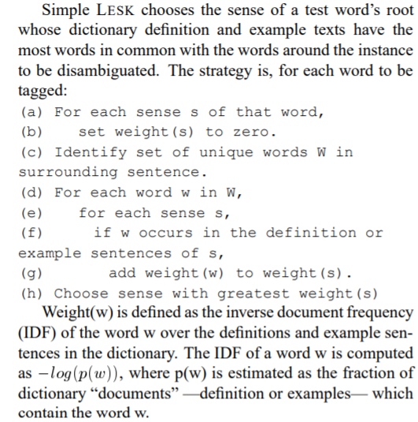
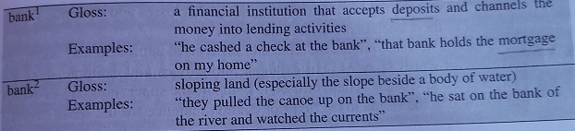
Method 2
Use the Simple LESK algorithm for WSD
Choose the sense whose gloss matches the neighboring words
Consider the input sentence: “The bank can guarantee deposits since it invests in mortgage securities”
sense of word bank?
Now check the WordNet Gloss and Examples
Correct sense of bank in the input sentence = bank¹
Kilgarriff, Adam, and Joseph Rosenzweig. "English Senseval: Report and Results." In LREC, vol. 6, p. 2. 2000.

Slide 7
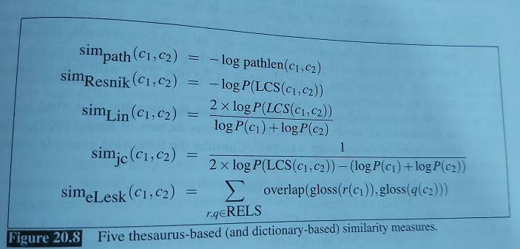
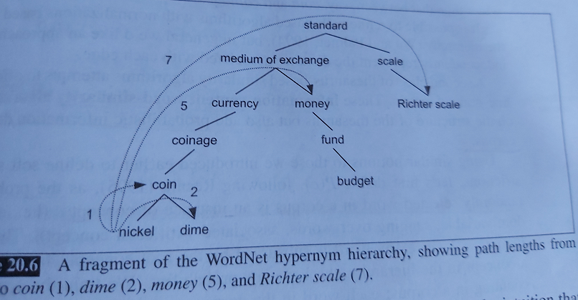
Method 3
Example: Use path length based similarity to compute the best sense from WordNet relation graph : sim_{path}(c₁ , c₂) ; where c₁ , c₂ are two synsets
SIMILARITY FORMULAE :

Slide 8
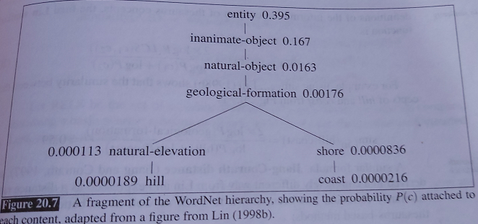
Method 4
Use RESNIK’s similarity to compute the best sense from WordNet relations sim_{Resnik}(c₁ , c₂)
LCS: Lowest common subsumer
Resnik, Philip. "WordNet and class-based probabilities." WordNet: An electronic lexical database (1998): 239-263.

Slide 9
Attempt the MOODLE Assignment related to Lectures 12, 13, 14

